Slide 1





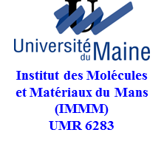




CNR DSFTM
Glass-Based
Sub-Wavelength Photonic Structures
Andrea Chiappini¹, Alessandro Chiasera¹, Anna Lukowiak^{1,2}, Davor Ristic^{1,3}, Iustyna Vasilchenko^{1,4}, Brigitte Boulard⁵, Claire Duverger Arfuso⁵, Cristina Armellini^{1,6}, Alessandro Carpentiero¹,
Stefano Varas¹, Simone Normani^{1,4}, Inas K. Battisha⁷, Gilles Cibiel⁸, Giancarlo C. Righini^{9,10},
Maurizio Ferrari¹
¹IFN – CNR CSMFO Lab., Via alla Cascata 56/C Povo, 38123 Trento, Italy
²Institute of Low Temperature and Structure Research, PAS, 50-422 Wroclaw, Poland
³Ruđer Bošković Institute, P.O. Box 180, 10002 Zagreb, Croatia
⁴Dipartimento di Fisica, Università di Trento, via Sommarive 14, Povo, 38123 Trento, Italy
⁵IMMM, UMR 6283, Equipe Fluorures, Université du Maine, Le Mans, France
⁶FBK Center for Materials & Microsystems, Via Sommarive 18, Povo 38123 Trento, Italy
⁷National Research Center, 12622 Dokki, Giza, Egypt
⁸Centre National d’Etudes Spatiales (CNES), 31401 Toulouse Cedex 9, France
⁹IFAC - CNR, MiPLa.b, Via Madonna del Piano 10, 50019 Sesto Fiorentino, Italy
¹⁰Museo Storico della Fisica e Centro di Studi e Ricerche Enrico Fermi, P.zza Viminale 1, 00184 Roma, Italy
Notes:
1

Slide 2
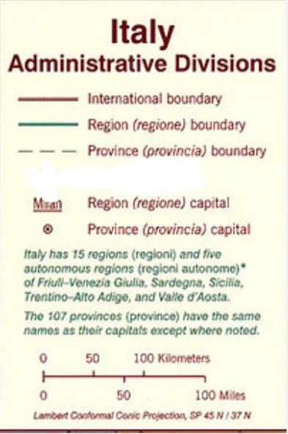
Institute for Photonics and Nanotechnologies (IFN)
lighting the way ahead
Notes:
2

Slide 3
                OUTLINE
                Motivation of Glass Photonics Research
                Glass Ceramics
                § Down conversion systems
                § SnO₂ nanocrystals as sensitizers
                Photonic Crystals
                § Opals
                § 1D microcavities
                Spherical microresonators
                Conclusions and Perspectives

Slide 4

CNR DSFTM
Motivation of Glass Photonics Research
Notes:
4

Slide 5
MOTIVATION
Light control
Nano scale confined structures
Micro scale confined structures
Glass-ceramic waveguides
Photonic crystals (n-D, Fibers)
Colloidal systems
Fibers and Waveguides
Resonators
Cavities
Novel materials, functionalizations, and geometries

Slide 6
WE START FROM:
AND……………

Slide 7
25 THz
Low loss window
(< 0.3 dB/Km) is
200 nm wide
More channels
Largely-spaced
channels
Non-zero dispersion
WDM CHANNELS
Range of high Gain EDFAs 4 THz

Slide 8
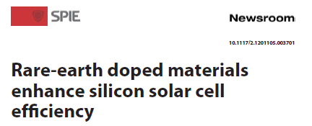

Glass Ceramics and Energy Transfer
          Tb³⁺ and Yb³⁺ ions in sol-gel derived
          SiO₂-HfO₂ glass ceramic planar waveguides

Slide 9
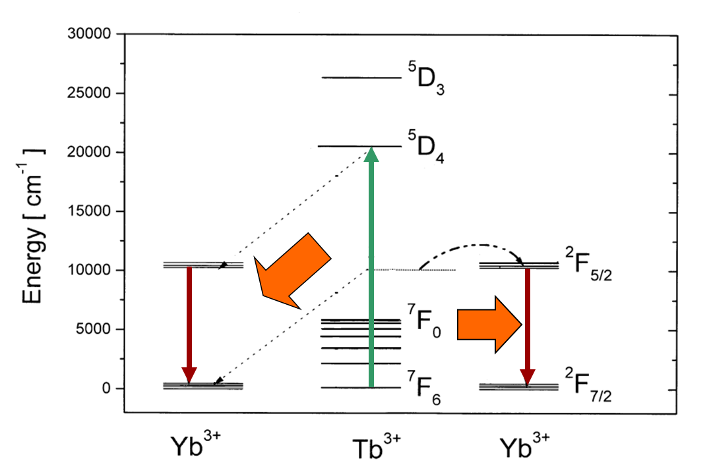
Down conversion with Tb³⁺/ Yb³⁺
One green photon @ 488nm
Two red photon @ 980 nm

Slide 10
Down-converters Silica-Hafnia glass ceramics
Low phonon energy (∼ 700 cm⁻¹)
Rare earth solubility
Combine spectroscopic properties of the crystal with optical properties of the glass
Determine the efficiency of the process
Optimize the rare earth ions content
10

Slide 11
Prepared waveguides
Rare earth concentration, refractive index and thickness of the waveguides
Sample label | Terbium concentration in mol% | Ytterbium concentration in mol% | n@543.5 nm TE polarization [± 0.001] | n@632.8 nm TE polarization [± 0.001] | Layer thickness [±0.2µm]
AR1 | 0.5 | 0 | 1.621 | 1.616 | 1.0
A1 | 0.5 | 1 | 1.626 | 1.621 | 1.0
A2 | 0.5 | 2 | 1.631 | 1.626 | 1.0
A3 | 0.5 | 3 | 1.633 | 1.628 | 1.1
BR1 | 0.2 | 0 | 1.623 | 1.617 | 1.1
B1 | 0.2 | 0.8 | 1.604 | 1.608 | 0.9
BR3 | 0.6 | 0 | 1.624 | 1.620 | 1.1
B3 | 0.6 | 2.4 | 1.630 | 1.625 | 1.2
BR5 | 1 | 0 | 1.626 | 1.621 | 1.2
B5 | 1 | 4 | 1.638 | 1.633 | 1.1

Slide 12
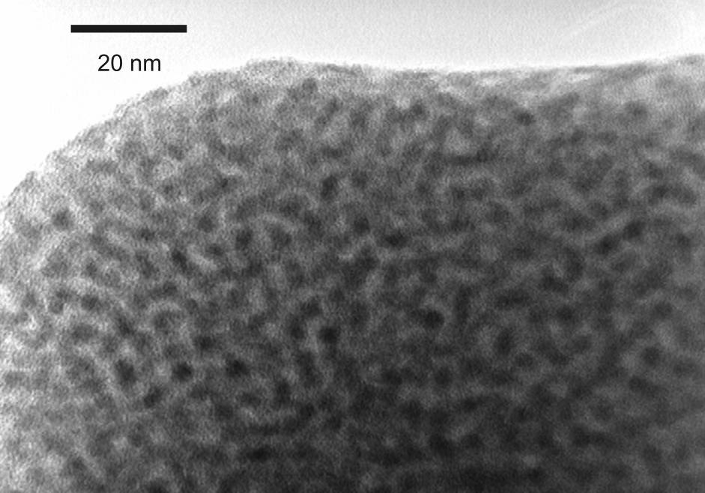
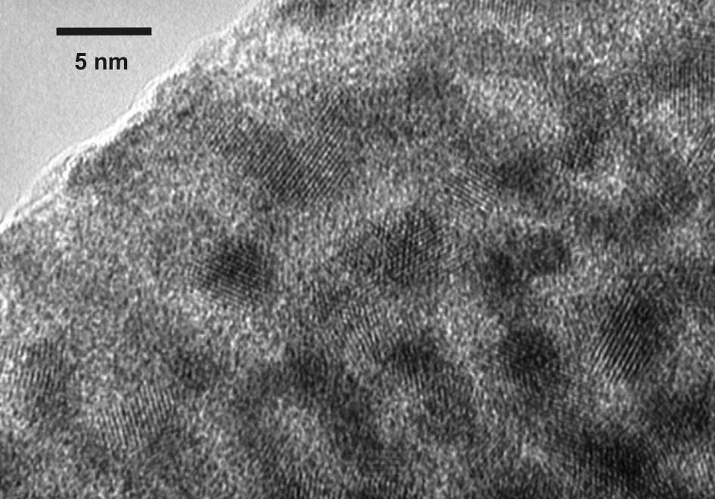
TEM images
Validation of the process: Incorporation of hafnia nanocrystals in the waveguide
Nanocrystals identified as monoclinic HfO₂
Size of about 3-4 nm

Slide 13
Photoluminescence spectra
Room temperature photoluminescence spectra of the ²F_{5/2}→²F_{7/2} transition of Yb³⁺ ions after excitation at 476 nm for the three samples of the first series. Each spectrum was normalized to the maximum of the luminescence intensity.
The emission of the Yb³⁺ ion after excitation at 476 nm is a indication of the presence of an efficient energy transfer from Tb³⁺ to Yb³⁺.
Tb 0.5 mol%
A1 1 mol% Yb
A2 2 mol% Yb
A3 3 mol% Yb
However, it is not possible to evaluate the conversion efficiency only on the base of the photoluminescence spectra.
The TE₀ mode waveguiding excitation was used for luminescence measurements, by detecting the light coming out from the waveguide surface. Luminescence spectroscopy was performed using the 476 nm line of an Ar⁺ ion laser as excitation source at 600 mW power.

Slide 14
Decay curves analysis
Energy transfer efficiency between Tb³⁺ and Yb³⁺ :
The relation between the transfer efficiency and the effective quantum efficiency is linear and is defined as:
η_{EQE} = η_{Tb-r}(1-η_{Tb-Yb})+2η_{Tb-Yb}
where the quantum efficiency for Tb³⁺ ions, η_{Tb-r}, is set equal to 1.
Decay curves of the luminescence from the ⁵D₄ metastable state of Tb³⁺ ions for the first samples series under excitation at 355 nm.
14

Slide 15
Tb³⁺/ Yb³⁺ down conversion efficiency
Transfer efficiency and effective quantum efficiency as a function of Yb³⁺ molar concentration for A samples where Tb³⁺ content is fixed at 0.5 mol%
Composition (Yb concentration in mol%) | 1% | 2% | 3%
Estimated transfer efficiency (in glass ceramic) | 14% | 24% | 25%
Estimated effective quantum efficiency (in glass ceramic) | 114% | 124% | 125%
Estimated transfer efficiency (in glass) | 2% | 4% | 6%
Estimated effective quantum efficiency (in glass) | 102% | 104% | 106%
For compositions with Tb³⁺ content kept constant at 0.5 mol% and increasing Yb³⁺ molar concentration, we observed that:
the Tb-Yb energy transfer efficiency increases with the increase of the molar ratio Yb/Tb;
the energy transfer efficiency does not exceed 24-25%.

Slide 16
SnO₂-SiO₂ Glass-Ceramic Waveguides
Heat Treatment at
900, 1000, 1100 ºC for 30’- 5h
Samples:
92 SiO₂ - 8 SnO₂ : 1 mol% Eu³⁺_HT at 800, 900, 1000, 1100°C for 30’.
84 SiO₂ - 16 SnO₂ : 1 mol% Eu³⁺_HT at 800, 900, 1000, 1100°C for 30’.
75 SiO₂ - 25 SnO₂ : 1 mol% Eu³⁺_HT at 800, 900, 1000, 1100°C for 30’, 1100 °C for 1h and 5h.
S.N.B. Bhaktha, F. Beclin, M. Bouazaoui, B. Capoen, A. Chiasera, M. Ferrari, C. Kinowski, G.C. Righini, O. Robbe, S. Turrell
“Enhanced fluorescence from Eu³⁺ in low-loss silica glass-ceramic waveguides with high SnO₂ content”
Applied Physics Letters 93 (2008) pp. 211904-1/3.
T.T. Van Tran, T. Si Bui, S. Turrell, B. Capoen, P. Roussel, M. Bouazaoui, M. Ferrari, O. Cristini, and C. Kinowski
“Controlled SnO₂ nanocrystal growth in SiO₂-SnO₂ glass-ceramic monoliths”
Journal of Raman Spectroscopy 43 (2012) pp. 869-875.

Slide 17
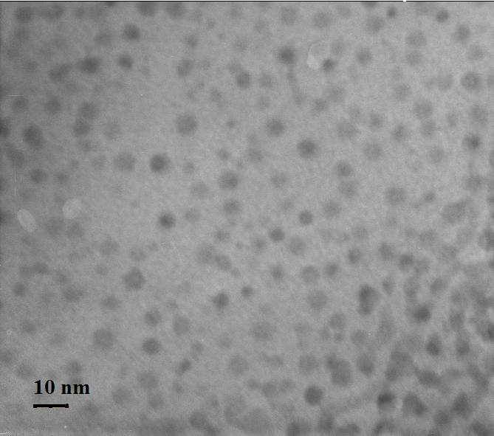
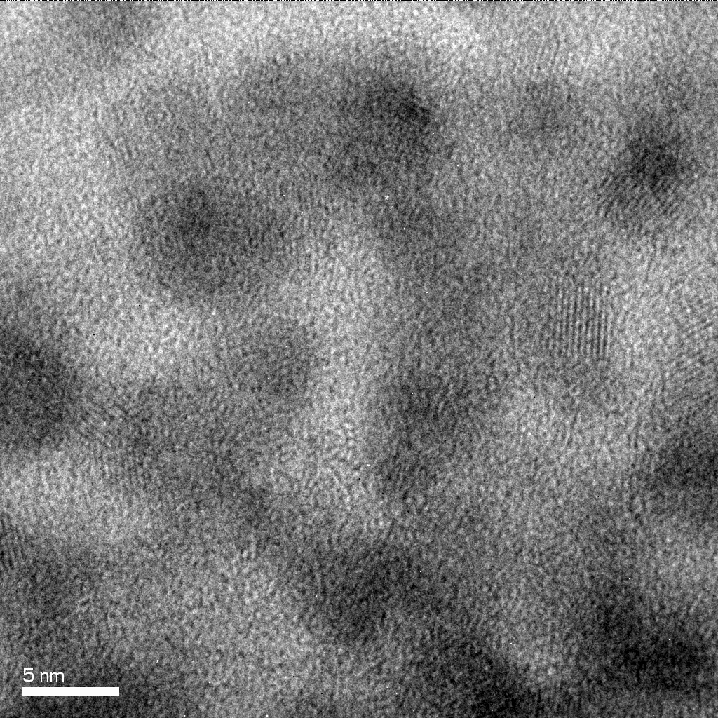
TEM
Homogeneous distribution
About 4 nm NCs

Slide 18
Raman spectra
Boson
T-O-T
(T = Si or Sn)
Si-O-Si symmetric stretching
ω = S_{l,n}
v
Lc
ω = wavenumber
v = sound velocity
L = particle size
c = speed of light
SnO₂ crystal
shoulder
Crystal-peak observed in the low-frequency region.
Increasing shoulder centered around 550 cm⁻¹ is attributed to the SnO₂ crystals.

Slide 19
Excitation spectra
Room temperature excitation spectra of ⁵D₀ → ⁷F₂ emission at 613 nm
x=mol%SnO₂
The broad and strong band observed at 310 nm (4.0 eV) corresponds to the SnO₂ band-gap energy.

Slide 20
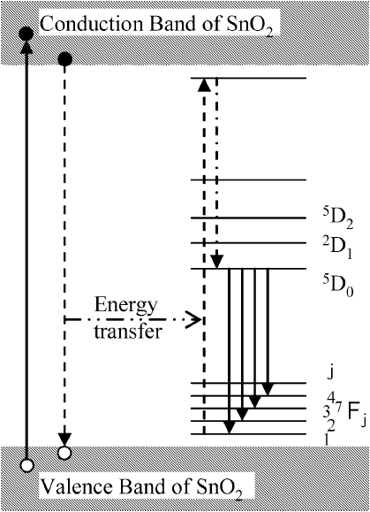
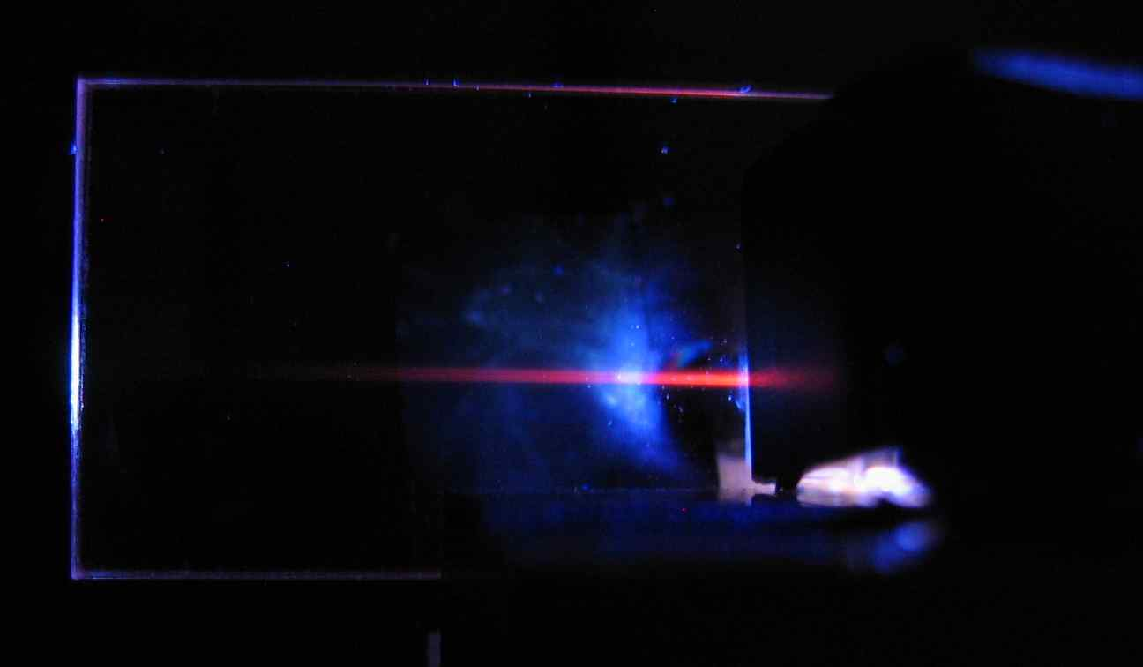
PL spectra
λ_{ex}=351nm
⁵D₁
For annealing temperature higher than 900 °C the emission features typical of Eu³⁺ ion in a crystalline like environment are predominant, indicating that most part of Eu³⁺ ions are embedded in SnO₂ nanocrystals

Slide 21
Enhanced fluorescence from Eu³⁺ in low-loss silica glass-ceramic waveguides with high SnO₂ content
λ_{ex} = 351 nm
S.N.B. Bhaktha, F. Beclin, M. Bouazaoui, B. Capoen, A. Chiasera, M. Ferrari, C. Kinowski, G.C. Righini, O. Robbe, S. Turrell, “Applied Physics Letters 93 (2008) pp. 211904-1/3.
Crack-free and low loss glass ceramic waveguide 75SiO₂-25SnO₂: Eu³⁺ fabricated by sol gel, dip-coating method. Losses remain below 0.8 dB/cm.

Slide 22
High photosensitivity in low-loss sol-gel
SiO₂ – SnO₂ waveguides
Effective index change at 1550 nm for the single mode waveguide after the UV irradiation at 248 nm as a function of cumulative doses used. The solid line is an help for the eyes.
S.Berneschi, S.N.B. Bhaktha, A. Chiappini, A. Chiasera, M. Ferrari, C. Kinowski, S. Turrell, C. Trono, M. Brenci, I. Cacciari, G. Nunzi Conti, S. Pelli, G. C. Righini “Highly photorefractive Eu³⁺ activated sol-gel SiO₂ – SnO₂ thin film waveguides”
Proceedings of SPIE Vol. 7604 (2010) pp. 76040Z-1/6

Slide 23
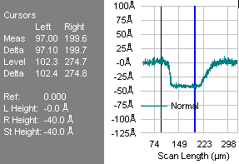
High photosensitivity in low-loss sol-gel
SiO₂ – SnO₂ waveguides
A swelling of about 4 nm was observed in UV exposed regions
B.N. Shivakiran Bhaktha, Simone Berneschi, Gualtiero Nunzi Conti, Giancarlo C. Righini, Andrea Chiappini, Alessandro Chiasera, Maurizio Ferrari, Sylvia Turrell
“Spatially localized UV-induced crystallization of SnO₂ in photorefractive SiO₂-SnO₂ thin film”.
Proceedings of SPIE Vol. 7719 (2010) pp. 77191B-1/5.
S.Berneschi, S.N.B. Bhaktha, A. Chiappini, A. Chiasera, M. Ferrari, C. Kinowski, S. Turrell, C. Trono, M. Brenci, I. Cacciari, G. Nunzi Conti, S. Pelli, G. C. Righini “Highly photorefractive Eu³⁺ activated sol-gel SiO₂ – SnO₂ thin film waveguides”
Proceedings of SPIE Vol. 7604 (2010) pp. 76040Z-1/6

Slide 24
CNR DSFTM
Photonic Crystals
Opals: a suitable photonic structure for light confinement
Notes:
24

Slide 25
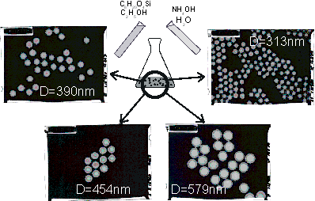
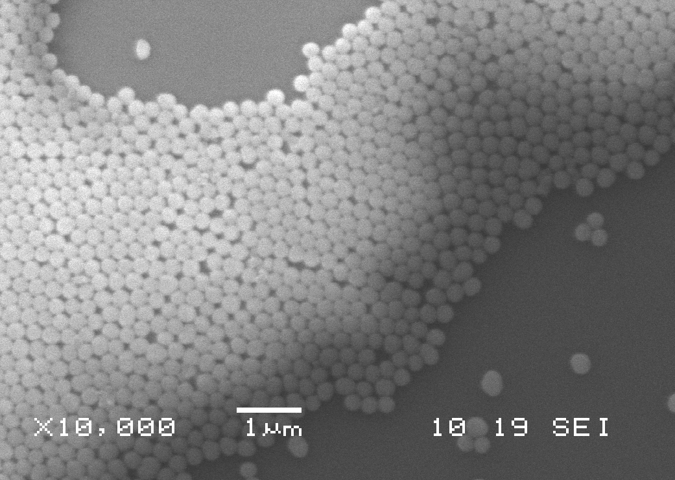
Molar Concentrations
Stober Methods
[TEOS] = 0.22 M
[NH₃] = 1.0 M
[H₂0] = 15.0 M
Silica Spheres
the dimension of :~255nm
high uniformity of silica spheres
(less than 5% of dispersion in diameter)
The reaction takes place at room temperature and
we can control the particle size through the concentration of a single reactive.
Notes:
The starting point to the synthesis the silica submicron spheres is using the so called Stober method. It take place by the hydrolysis and the condesation/polimerisation reactions where the TEOS is using as starting reagents in an alcoholic solution of water and ammonia, where the ammonia itself plays the role of catalyst.
To the take in mind is we can control the particles size through the molar concentration of every single reactives. In our particular case

Slide 26
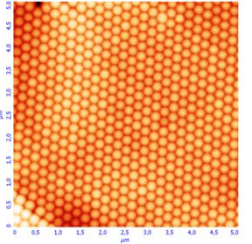
3D Photonic Crystals bottom-up approach
Self-Assembling
colloidal nano-microspheres
Low cost
associated with their manufacture
“Easy”
relative easiness of preparation
AFM image of the top surface of the opal formed by spin-coating technique of 236 nm diameter polystyrene spheres.
A.Chiappini, C. Armellini, A. Chiasera, M. Ferrari, L. Fortes, M. Clara Gonçalves, R. Guider, Y. Jestin, R Retoux, G. Nunzi Conti, S. Pelli, Rui M. Almeida, and G.C. Righini. “An alternative method to obtain directs opal photonic crystals structures” Journal of Non-Crystalline Solids 355 (2009) pp. 1167-1170
Notes:
Photonic crystals can be viewed just as a subclass of a larger family of
material systems called metamaterials

Slide 27
Polystyrene monosized spheres
Single-stage polymerization process based on formation and growth of polymeric nuclei dispersed in an emulsion constituted by water, styrene, potassium persulfate (KPS) and sodium docecyl sulfate (SdS).
HRTEM characterization of polystyrene spheres synthesized by microemulsion, where an average dimension of 236 nm with a polidispersivity of about 3% is determined
Range 150 ÷ ~ 1000 nm
Control the size of the particles through the concentration
of sodium docecyl sulfate.
Notes:
27
The main future of the structure of amorphous materials is the absence of the long range order , which it is important to know the structure of the material to understand thear physical and or chemical properties
As we will see after.

Slide 28
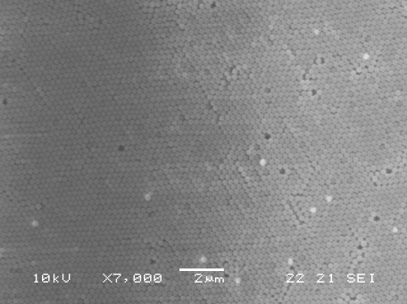
Self Assembly approach
Self Assembly techniques
Vertical Deposition
A. Chiappini, C. Armellini, A. Chiasera, M. Ferrari, Y. Jestin, M. Mattarelli, M. Montagna, E. Moser, G. Nunzi Conti, S. Pelli, G.C. Righini, M. Clara Gonçalves, Rui M. Almeida, "Design of photonic structures by sol–gel-derived silica nanospheres" Journal of Non-Crystalline Solids 353 (2007) pp. 674–678.
Notes:
28
The main future of the structure of amorphous materials is the absence of the long range order , which it is important to know the structure of the material to understand thear physical and or chemical properties
As we will see after.

Slide 29
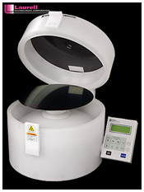
“Bottom up approch “
Self Assembly techniques
Spin-coating deposition
C. Armellini, A. Chiappini, A. Chiasera, M. Ferrari, Y. Jestin, E. Moser, G. Nunzi Conti, S. Pelli, A. Quandt, G.C. Righini, C. Tosello
“Er³⁺ - activated nanocomposite photonic glasses and confined structures”
Optical Materials 31 (2009) pp. 1071-1074.
Notes:
29
The main future of the structure of amorphous materials is the absence of the long range order , which it is important to know the structure of the material to understand thear physical and or chemical properties
As we will see after.

Slide 30
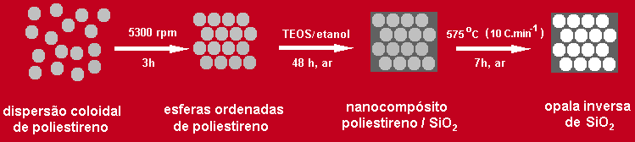
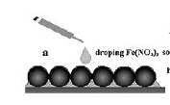
Silica inverse opals
Latex opals as templates
Silica solution
D= 236nm
Polystyrene Colloidal particles
2
Thermal heat-treatment
1
3
HT: 450°C
0.1 °C/min
0.3 mol % Er³⁺
4
Spin deposition technique
HT: 900°C
Monodisperse particles in DW solution.

Slide 31
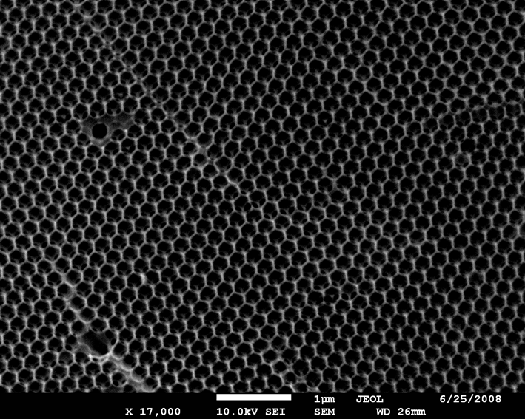
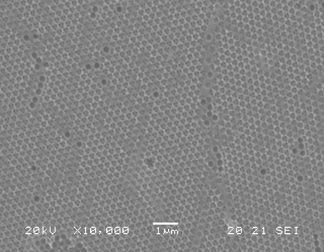
Inverse structure
It’s a negative replica of direct opal (template)
Hollow regions of air spheres
well ordered in a triangular lattice corresponding to the (111) planes
of a fcc crystalline strucure.
The average dimension of the air-hollows is ~210 nm

Slide 32
Optical Properties
Bragg’s Law
Variable incident angle reflectance measurements of inverse opals
Filling Factor 23%
Max 26%

Slide 33
Luminescence at 1.5µm
peak at 1540 nm
1567 nm
1490 nm
16.8±0.1 ms
1617 nm
Room temperature photoluminescence spectrum of the ⁴I_{13/2} → ⁴I_{15/2} transition of Er3+ ions
η= 90%
C. Armellini, A. Chiappini, A. Chiasera, M. Ferrari, Y. Jestin, E. Moser, R. Retoux, G. Speranza, L. Minati, G. Nunzi Conti, S. Berneschi, I. Cacciari, S. Pelli, G.C. Righini.
“Fabrication and Characterization of Silica Opals”
Advances in Science and Technology Vol. 55 (2008) pp 118-126.

Slide 34
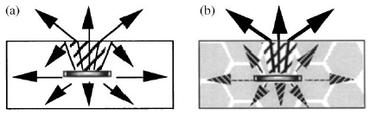
Photonic Crystals - fundamentals
Why are Photonic Materials special?
Improvement of LED efficiency.
(b) microstructured emitter: light that would not radiate into the emission cone is suppressed by the photonic crystal, i.e. there are no modes for the emission to radiate into, so all spontaneous emission is channeled into the “useful” modes of the device. In principle, the external effiency of such a device can reach the internal efficiency of the material of > 90%.

Slide 35
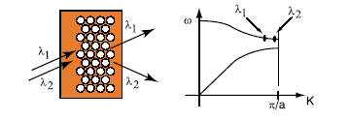
Photonic Crystals - application
Superprism effect
The figure shows how the dispersion properties of a photonic crystal can be used. Due to the high dispersion of wavelengths near the band edge, it is possible to separate the spectral contents of an incoming multi-wavelength signal. This particular effect is known as "superprism"

Slide 36
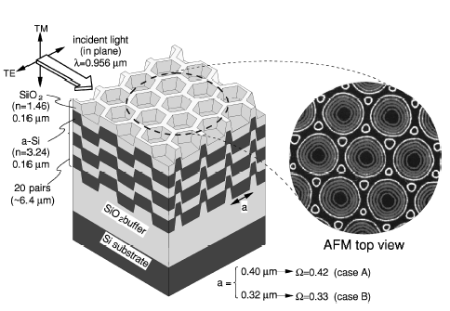
Photonic Crystals - application
Superprism effect
The self-organized 3D photonic crystal, with the stacking structure analogous to that of simple hexagonal graphite, employed to demonstrate superprism effect in the optical frequency region.
H. Kosaka, T. Kawashima, A. Tomita, M. Notomi, T. Tamamura, T. Sato, and S. Kawakami “Superprism phenomena in photonic crystals”, Phys. Rev. B 58 (1998) pp. R10 096-R10 099.

Slide 37
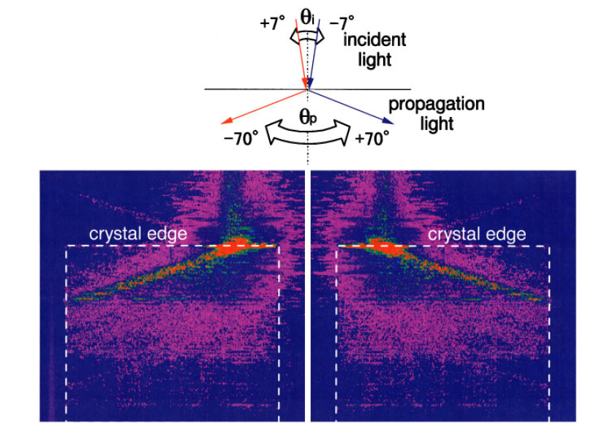
Photonic Crystals - application
Superprism effect
Photographs showing light-beam swing inside the photonic crystal. The tilting angle of the incident light was slightly altered from +7° (left) to -7° (right). Both paths show negative bending. The incident light has a wavelength 956 nm (λ/a=0.33) with TM polarization. The crystal size is 0.5 mm x 0.5 mm.
H. Kosaka, T. Kawashima, A. Tomita, M. Notomi, T. Tamamura, T. Sato, and S. Kawakami “Superprism phenomena in photonic crystals”, Phys. Rev. B 58 (1998) pp. R10 096-R10 099.

Slide 38
Photonic Crystals - application
Superprism effect
If Snell’s law is applied without regard to the photonic band anisotropy, this phenomenon implies a negative refractive index.
H. Kosaka, T. Kawashima, A. Tomita, M. Notomi, T. Tamamura, T. Sato, and S. Kawakami “Superprism phenomena in photonic crystals”, Phys. Rev. B 58 (1998) pp. R10 096-R10 099.

Slide 39
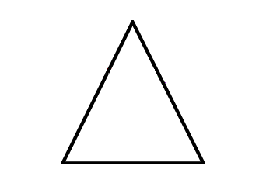
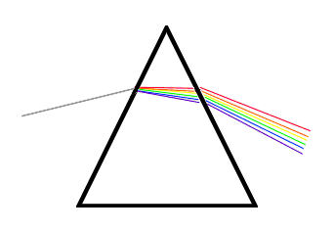
Photonic Crystals - application
Superprism effect
∼ 10°
Δλ = 1%
0.99 μm – 1μm
λ₆
λ₁>λ₆
λ₅
λ₄
~ 50°
λ₃
λ₂
λ₁
X 500
Conventional prism
Superprism
made of Photonic Crystal
H. Kosaka, T. Kawashima, A. Tomita, M. Notomi, T. Tamamura, T. Sato, and S. Kawakami “Superprism phenomenaSuperprism Phenomena in Photonic Crystals: Toward Microscale Lightwave Circuits”, Journal of Lightwave Technology, 17 (1999) pp. 2032-2038.

Slide 40
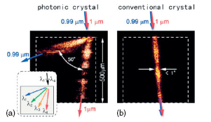
Photonic Crystals - application
Superprism effect
(a) light paths inside a PC with incident light of 0.99-μm and 1.0-μm wavelengths. A large swing reaching 50° was achieved with a slight wavelength change of 1%. The incident light was polarized in the TM mode and tilted at 15° from normal to the crystal edge and
(b) light propagation in a conventional Si crystal under the same condition as (a). The two beams with different wavelengths traced almost the same paths.
H. Kosaka, T. Kawashima, A. Tomita, M. Notomi, T. Tamamura, T. Sato, and S. Kawakami “Superprism phenomenaSuperprism Phenomena in Photonic Crystals: Toward Microscale Lightwave Circuits”, Journal of Lightwave Technology, 17 (1999) pp. 2032-2038.

Slide 41
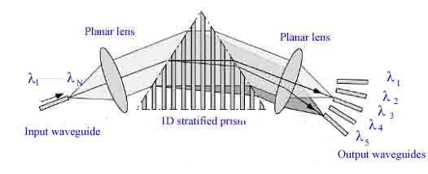
Photonic Crystals - application
Superprism effect: 1D superprism (plan view)
A. Bakhtazad, A.G. Kirk, “Superprism effect with planar 1-D photonic crystal”, Proceedings of the SPIE, Volume 5360, pp. 364-372 (2004)

Slide 42
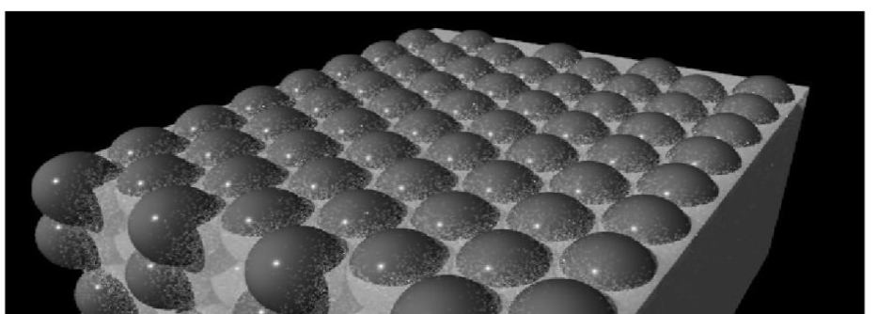
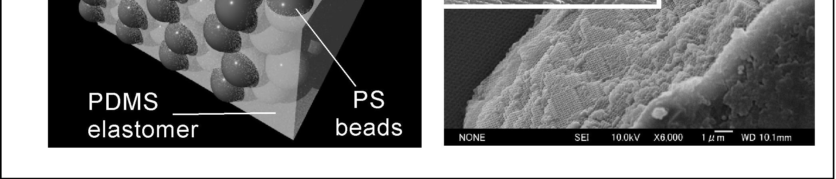
Strain Sensor
Material: Changing the structural color under an external stimulus
Recognize this by naked eyes
How it works?
Blue shift of the wavelenght of the diffraction peak as a function of the applied strain

Slide 43
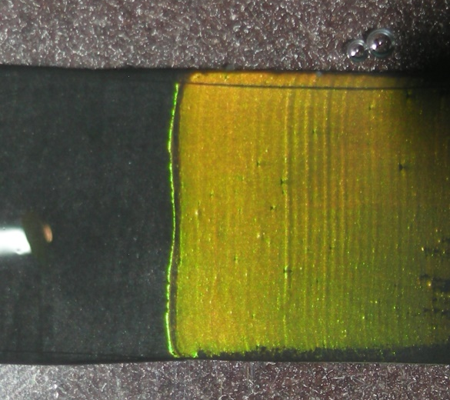
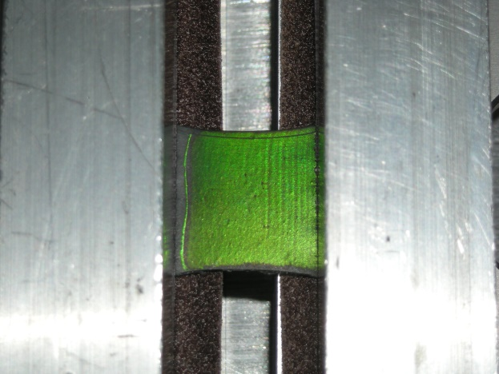
Strain Sensor
Experimental validation
Initial
Experimental set-up
L
Applied strain
L + ΔL
D. Zonta, A. Chiappini, A. Chiasera, M. Ferrari, M. Pozzi, L. Battisti, M. Benedetti, Proc. of SPIE 7292 (2009) pp. 729215-1 - 729215-10.

Slide 44


Strain Sensor
Response Characterisation
d_{111,} decreases linearly
Linear response
Peak position blue shifts from 583 to 550 nm
the position of the peak does not change significantly,
^{Inter lanar} distance remains constant for the applied strain,
since the PS spheres are in contact with each other
D. Zonta, A. Chiappini, A. Chiasera, M. Ferrari, M. Pozzi, L. Battisti, M. Benedetti, Proc. of SPIE 7292 (2009) pp. 729215-1 - 729215-10.

Slide 45
Possible applications
  Strain sensor
  SERS substrate
Metallo – dielectric structures

Slide 46
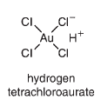
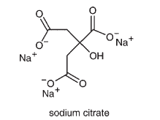
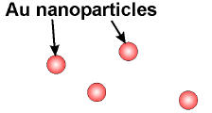
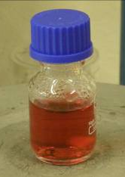
Gold nanoparticles
How to prepare?
Turkevich Method (1951)
Turkevich, J.; Stevenson, P. C.; Hillier, J. Nucleation and Growth Process in the Synthesis of Colloidal Gold. Discuss. Faraday Soc. 1951, 11, 55-75.
Reduction of Gold ion by citrate ions
+
^{chloroauric acid}
^{chloroauric acid}
^{chloroauric acid}
LSPR = 520 nm
Notes:
46
First metallic nanostructures investigated were nano-particles.
see different sized colloids in solution.
Faraday noted that the colour of the particles depend on size.
Particles give fields at surface so used for SERS, but difficult coupling and poor reproducibility.
Voids, colour tunes with size. Easy coupling by geometry.

Slide 47
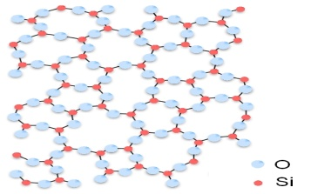
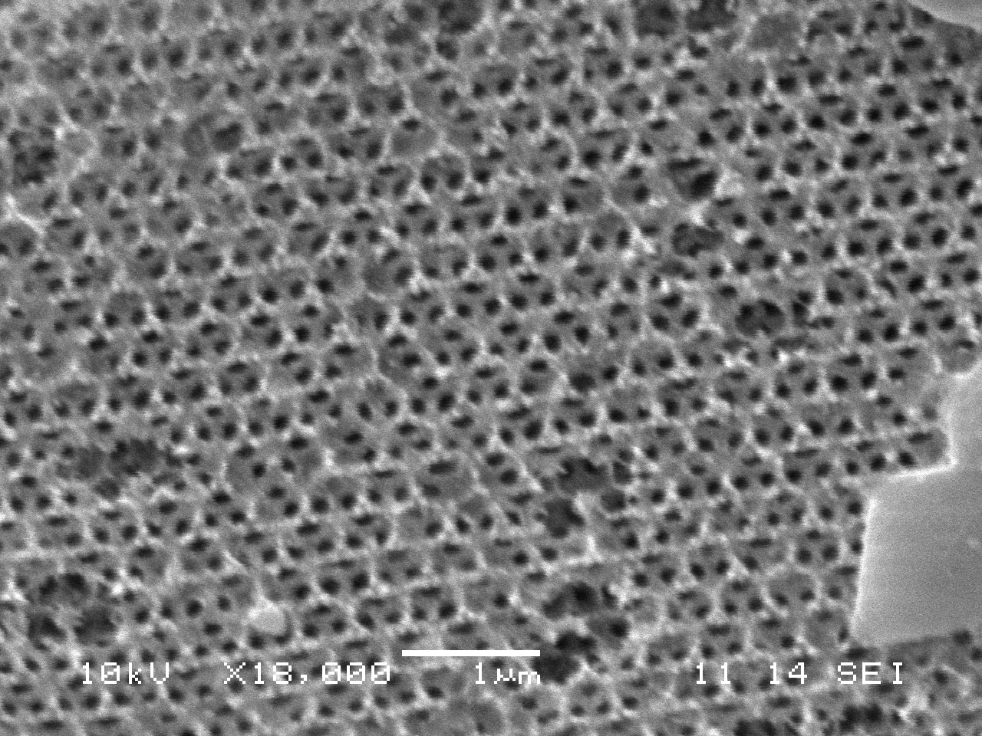
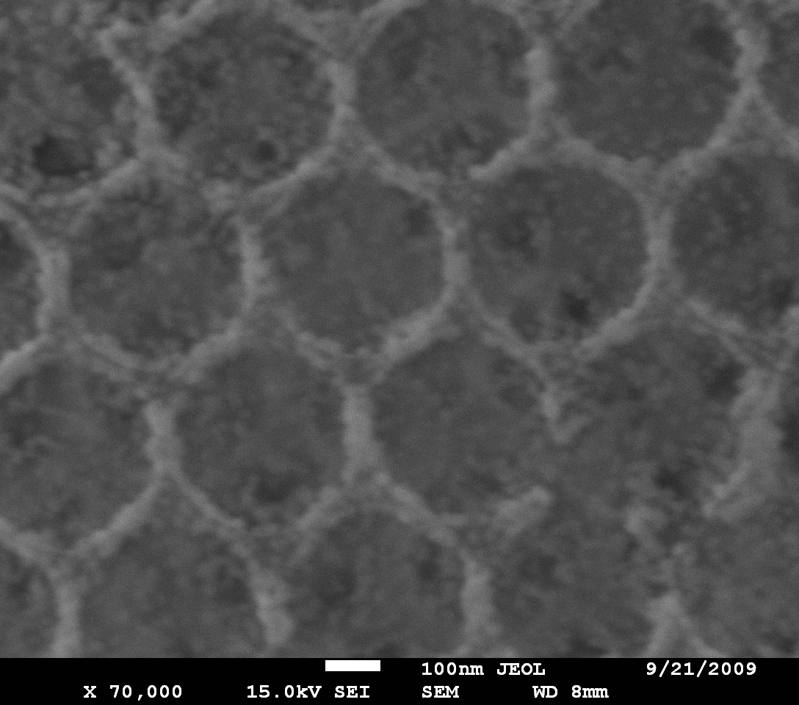
Structural Properties
Inverse ordered structure is still present after immersion process
hollow regions of the air spheres
(well ordered in a triangular lattice corresponding
to the (111) planes of a fcc crystalline structure)
inner dark holes
(representing the point of contact between each
templating sphere and its 12 nearest neighbors)
After 2 h immersion time
After 10 h immersion time
Au Nps are attached/immobilized on the network of the ISO system
Notes:
47
The main future of the structure of amorphous materials is the absence of the long range order , which it is important to know the structure of the material to understand thear physical and or chemical properties
As we will see after.

Slide 48

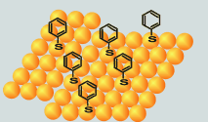
Raman Signal Enhancement
MDCS systems have been tested as SERS substrate
benzenethiol (BT) as a probe molecule
1x10⁻³M
using a 10 s accumulation time, incidence power 100 µW.
to evaluate the efficiency of the MDCS
we have compared the Raman signal obtained for these structures with those collected :
b) on a gold film (GF) deposited by sputtering
c) on ISO spotted with a 5 µl drop of pure BT and left to dry out (ISO_BT).
Notes:
48
The main future of the structure of amorphous materials is the absence of the long range order , which it is important to know the structure of the material to understand thear physical and or chemical properties
As we will see after.

Slide 49
Raman Signal Enhancement
Notes:
49
The main future of the structure of amorphous materials is the absence of the long range order , which it is important to know the structure of the material to understand thear physical and or chemical properties
As we will see after.

Slide 50
CNR DSFTM
Photonic Crystals
HIGH QUALITY FACTOR 1-D Er³⁺-ACTIVATED DIELECTRIC MICROCAVITY FABRICATED BY RF-SPUTTERING
Notes:
50

Slide 51
Fabrication Protocol – Target composition
TiO₂
SiO₂
Active layer half wave SiO₂ activated with Er³⁺ ions.
Bragg Mirror 10 alternated quarter wave layers TiO₂ and SiO₂
TiO₂ n = 2.20 (@ 1550 nm)
SiO₂ n = 1.44 (@ 1550 nm)
SiO₂ Target
Substrate: v-SiO₂, dim. 7 x 3cm
TiO₂ Target
Deposition is performed by sputtering alternatively the targets of silica and titania. The depositions were tailored to reach the appropriate thicknesses to obtain a cavity resonance centred at 1.7 μm
SiO₂ + Er Target

Slide 52
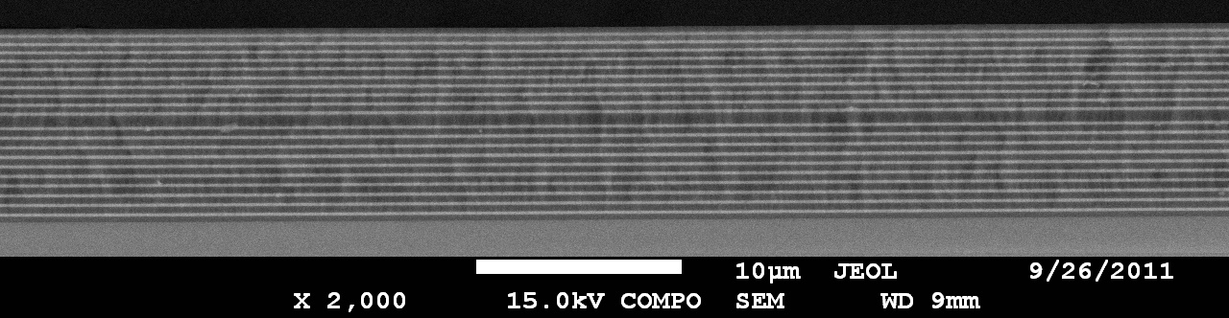
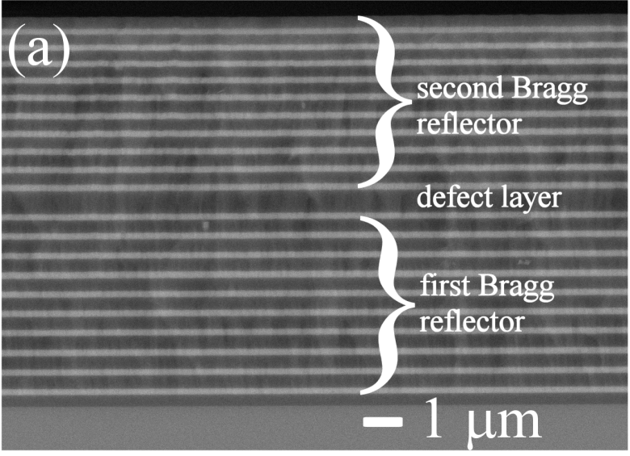
Development and optical and spectroscopic diagnostic of photonic materials and structures
1-D microcavities fabricated by RF-sputtering
Bragg Mirror: 20 alternated quarter wave layers TiO₂ (170 nm) and SiO₂ (320 nm).
Active layer: half wave (640 nm) SiO₂ activated with 0.2 mol % of Er³⁺.
The dark regions corresponds to SiO₂ and the white regions corresponds to TiO₂
S. Valligatla, A. Chiasera, S. Varas, N. Bazzanella, D.N. Rao, G.C. Righini, M. Ferrari, “High quality factor 1-D Er³⁺-activated dielectric microcavity fabricated by RF-sputtering”, Optics Express, Vol. 20 Issue 19, pp.21214-21222 (2012)

Slide 53
Transmission measurements
Transmittance spectrum of the cavity with two Bragg reflectors. The stop band range from 1490 to 1980 nm. The cavity resonance corresponds to the sharp maximum centred at 1.749 µm. The FWHM of the resonance is 1.97 nm that correspond to a quality Q factor of 890.

Slide 54
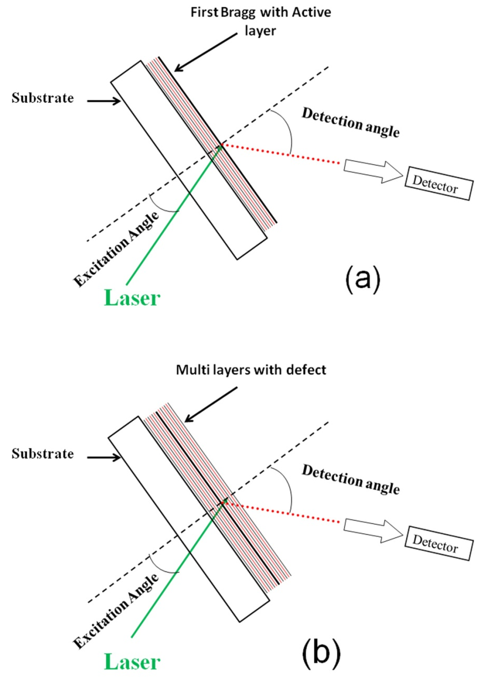
⁴I_{13/2}→⁴I_{15/2} photoluminescence spectra of the cavity activated by Er³⁺ ion in 1-D photonic crystal and of the single Er³⁺⁻doped SiO₂ active layer with first Bragg mirror. The light is recorded at 50° from the normal on the samples upon excitation at 514.5 nm.
Schematics of the excitation and detection geometries employed for a reliable assessment of the influence of the cavity on the 1.5 mm emission band of Er³⁺ ion.
Fig. (a): configuration employed for the Er³⁺-activated reference sample:
Fig. (b): configuration employed for the Er³⁺-activated 1-D microcavity.

Slide 55
CNR DSFTM
Spherical microresonators
Whispering Gallery Modes
Laser
Notes:
55

Slide 56
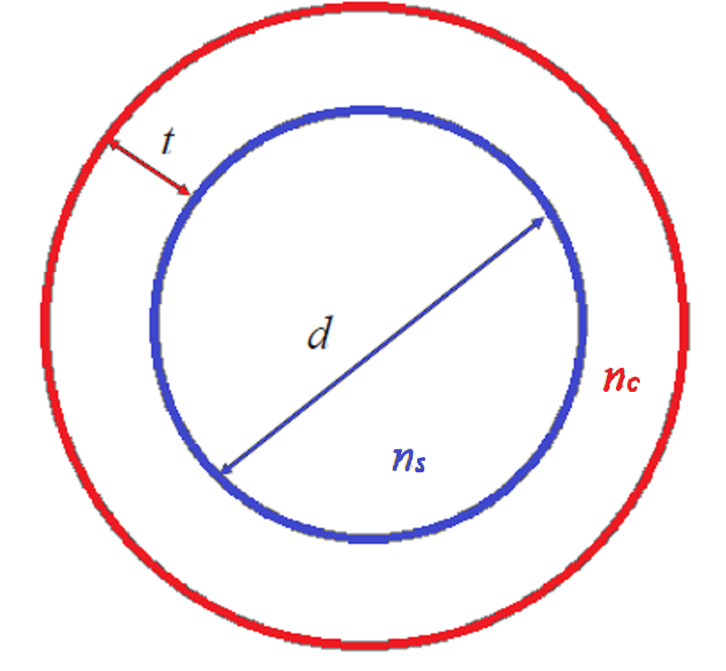
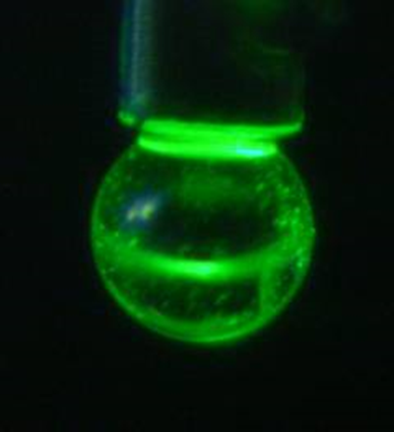
Spherical microresonators WGMs
Microsphere of diameter d and refractive index n_{s} coated by a film of thickness t and refractive index n_{c}.
G.C. Righini, Y. Dumeige, P. Féron, M. Ferrari, G. Nunzi Conti, D. Ristic, S. Soria., “Whispering gallery mode microresonators: fundamentals and applications”, Rivista del Nuovo Cimento 34 (2011) pp. 435-488.
D. Ristić, A. Rasoloniaina, A, Chiappini, P. Féron, S. Pelli, G. Nunzi Conti, M. Ivanda, G.C. Righini, G. Cibiel, and M. Ferrari “About the role of phase matching between a coated microsphere and a tapered fiber: experimental study” Optics Express, 21 (2013) pp 20954-20963

Slide 57
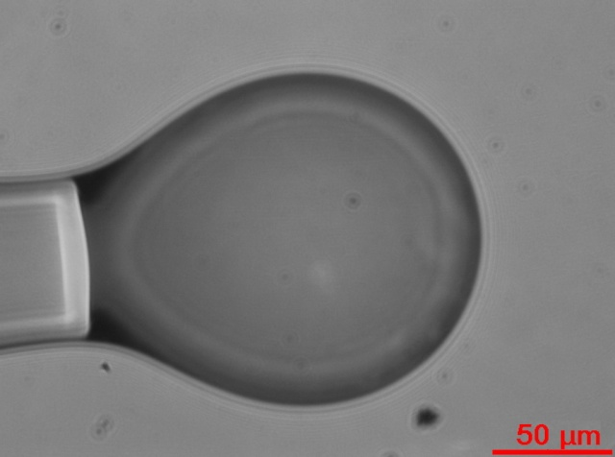
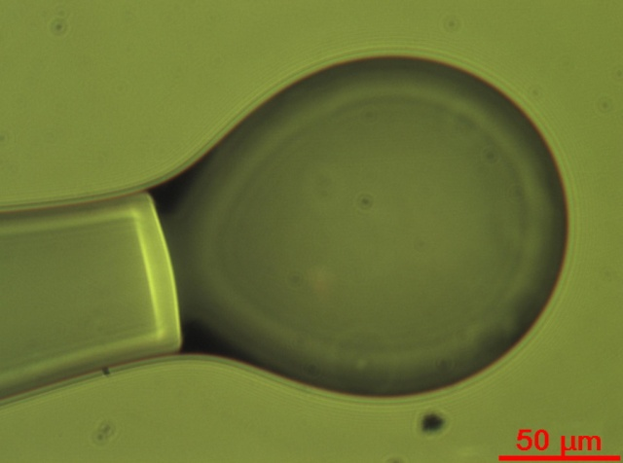
Glass coated microspheres
Silica microspheres fabricated by melting a SMF-28 rod. This glass presents a very low concentration of impurities (<0.3 ppm) and OH groups (<0.2 ppm), the attenuation coefficient is very low (≅ 0.2 dB/km at 1550 nm) The diameters and ellipticity are also reported
 | F1 | F2 | F3 | F4 | F5 | F6 | F7 | F8 | F9
d/μm [±5 μm] | 155 | 135 | 140 | 140 | 140 | 145 | 130 | 155 | 145
Ellipticity [±1%] | 4% | 7% | 4% | 5% | 7% | 5% | 4% | 3% | 3%
Microscope images of the F5 microsphere before and after coating
Before coating
After coating

Slide 58
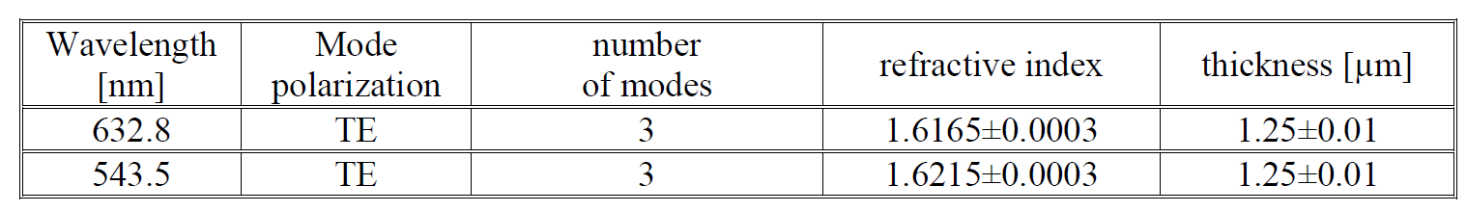
Glass coated microspheres
A waveguide was prepared as reference using the same sol and the same dip coating technique as for the microsphere in order to estimate the thickness and the refractive index of the coating
Thickness, refractive index, and modal parameters of the planar waveguide used as reference for the sol gel coating of the microsphere. Values are obtained by m-line measurement. The film composition was 70SiO₂-30HfO₂ activated with 0.3 mol% Er³⁺.

Slide 59
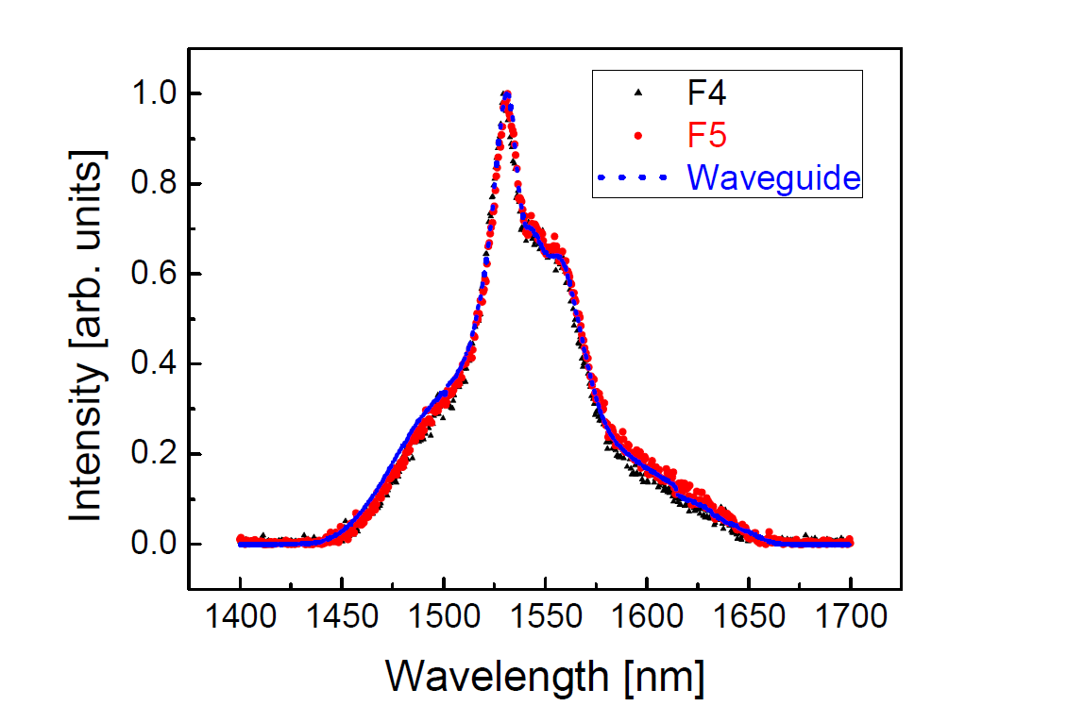
Glass coated microspheres
Room temperature photoluminescence spectra and decay curves of the ⁴I_{13/2} → ⁴I_{15/2} transition of Er³⁺ ions for the sol gel coated spherical microresonators and the planar waveguide used as reference. The film composition was 70SiO₂-30HfO₂ activated with 0.3 mo% Er³⁺.
All the photoluminescence spectra showed that the deposited films are amorphous, and that there is no difference between the shape of the spectra of different microspheres and the waveguide, indicating that the coating procedure is reproducible.

Slide 60
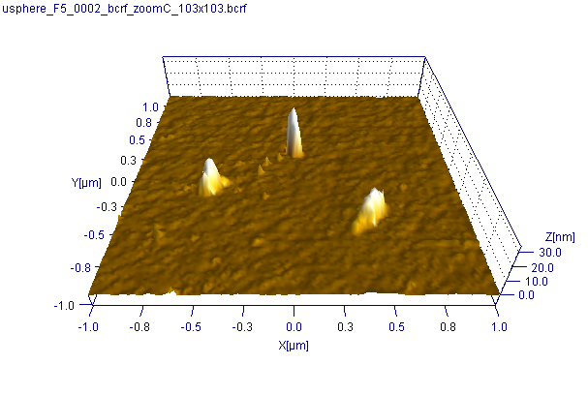
Glass coated microspheres – AFM
Two quantities were measured:
-The surface roughness
-The number of defects/μm²

Slide 61


Glass coated microspheres – Defects
Defect types
small defects (around 5 nm in height)
Big defects (>15 nm in height)
Holes (10 nm in depth)
A low number of defects is needed to achieve high Q-factors

Slide 62


Glass coated microspheres – Roughness
For the surface roughness measurements the areas with no defects were chosen
Uncoated
Coated

Slide 63

Glass coated microspheres – Surface assessment
Roughness calculated on 2x2 µm² areas
Defects counted on a
    20x20µm² image
    10x7µm² image
A 4th order bidimensional subtraction plus an histogram line-by-line levelling has been applied before computing the roughness
Defect density definition: (objects with Z_{max}>2 nm) numb./µm²

Slide 64

Glass coated microspheres – Near Field
Effect of the coating thickness on the coupling efficiency
The effective refractive index of the 70SiO₂-30HfO₂ coated microsphere as a function of the radius of the silica sphere for the fundamental equatorial (n=0; l-|m|=0) TE mode at 1560 nm. The refractive index of the sphere is 1.44 and of the coating 1.6. The coating thicknesses, given in μm, are also reported in the figure. The blue lines correspond to the border cases of no coating (blank sphere) or of very thick coating (bulk sphere with n=1.6). The horizontal dashed line corresponds to the effective refractive index of the propagation mode of a silica fiber taper with a waist of 3 μm. The vertical dashed line correspond to a silica sphere diameter of 155 μm which is the diameter of the sphere coated in our experiment.
Optics Express, 21 (2013) pp 20954-20963 “About the role of phase matching between a coated microsphere and a tapered fiber: experimental study “

Slide 65
Glass coated microspheres – Near Field
Effect of the coating thickness on the coupling efficiency
R= 68 μm
d= 0.5 μm
l = 400
N = 0
We need:
high amount of E. field in the coating
a reasonably long evanescent tail
d [μm] | l | R [μm] | E (sphere) | E (coating) | E (air)
0.2 | 388 | 68.0056 | 0.88637 | 0.05826 | 0.05537
0.3 | 391 | 68.0616 | 0.79013 | 0.13292 | 0.07695
0.5 | 400 | 67.9925 | 0.55117 | 0.3473 | 0.10153
0.7 | 409 | 67.996 | 0.38182 | 0.52335 | 0.09483
1 | 418 | 67.9822 | 0.23697 | 0.68933 | 0.07371
1.3 | 423 | 67.9418 | 0.15764 | 0.78497 | 0.05738

Slide 66
Glass coated microspheres – Laser WGMs
Effect of the coating thickness on the coupling efficiency
The average integrated luminescence in the 1535-1585 nm range for the 0.3 mol% Er³⁺ 70SiO₂-30HfO₂ coated sphere in respect to the number of dips and to the percentage of the fundamental WGM electric field (e. f.) inside the coating as calculated from the number of dips.

Slide 67

Glass coated microspheres – Near Field
The effect of the coating on the whispering gallery modes was studied
The coating used was 70 % SiO₂ – 30% HfO₂ doped with 0.3 mol % Er³⁺
The spheres (D=140±10 μm) were characterized using a tapered fiber

Slide 68

Glass coated microspheres – Laser WGMs
Excitation at 1.48 μm
Laser power: ≈ 120 mW.
The peak power of the detected modes was always in the range of nanowatts, the highest power detected being 30 nW.
WGM modes are clearly visible
Different modes are excited depending on the position of the taper
N=1.6
λ = 1550 nm (wavelength of the signal)
FSR is 3.7 nm corresponding to a microsphere of about 130 μm
Q-factor is greater than the resolution of our detector (>3x10⁴)

Slide 69
Thermal effects of coatings
Another important application of transparent coatings onto spherical microresonators concerns the possibility of reducing the thermal shift of the WGM resonances due to microsphere heating by the dissipated pump energy.
Actually, the shift is due both to the temperature-induced change in the refractive index (the thermo-optic coefficient) and to the temperature-induced increase of the diameter of the sphere (coefficient of thermal expansion)
Alessandro Chiasera, Yannik Dumeige, Patrice Féron, Maurizio Ferrari, Yoann Jestin, Gualtiero Nunzi Conti, Stefano Pelli, Silvia Soria, and Giancarlo C. Righini.“Spherical whispering-gallery-mode microresonators”Laser & Photonics Reviews 4 (2010) pp. 457-482

Slide 70

Thermal effects of coatings
λ is the WGM wavelength
T is the temperature
α is the thermal-expansion coefficient
N is the refractive index of the microsphere
One can also take advantage of this characteristic of the spherical WGMRs to accurately measure the thermo-optic coefficient of the material of which the microresonator is made
Alessandro Chiasera, Yannik Dumeige, Patrice Féron, Maurizio Ferrari, Yoann Jestin, Gualtiero Nunzi Conti, Stefano Pelli, Silvia Soria, and Giancarlo C. Righini.“Spherical whispering-gallery-mode microresonators”Laser & Photonics Reviews 4 (2010) pp. 457-482

Slide 71
Thermal effects of coatings
No red shift increasing
pump power
due to the silica-hafnia coating
Whispering gallery modes emission spectra of a silica microsphere of 250 μm in diameter and coated by a film of 70SiO₂-30HfO₂ activated with 1 mol% Er³⁺. The thickness of the coating is 0.8 μm. Spectra are obtained at different current of the 1480 nm pump laser.
Alessandro Chiasera, Yannik Dumeige, Patrice Féron, Maurizio Ferrari, Yoann Jestin, Gualtiero Nunzi Conti, Stefano Pelli, Silvia Soria, and Giancarlo C. Righini.“Spherical whispering-gallery-mode microresonators”Laser & Photonics Reviews 4 (2010) pp. 457-482

Slide 72
Conclusions and Perspectives
Photonic crystals that exhibit specific morphologic, structural, and optical properties allow to develop interesting new physical concepts, as well as novel photonic devices based on the control of the light.
RF – sputtering and colloidal route are complementary techniques suitable for fabrication of high Q 1-D photonic microcavities and versatile 3-D photonic opals activated by rare earth ions, respectively.
WGMs laser or frequency combs can be tailored by suitable coating of spherical microresonators
ACKNOWLEDGEMENTS:
CNES SHYRO project (2011-2015)
NSBMO research project (2010-2013)
Polish Ministry of Science and Higher Education “Mobility Plus” Program
SiMeCro research project (2012-2013) Caritro Foundation
MAE Significant Bilateral Project between Italy and Egypt titled “Smart optical nanostructures for green photonics (2013-2015)

Slide 73
Welcome to
CIMTEC 2014
Montecatini Terme, Italy - June 9-20, 2014
13th International Ceramics Congress (June 9-13, 2014)
&
6th Forum on New Materials (June 16-20, 2014)
Symposium CL
Inorganic Materials Systems for Optical and Photonic Applications
XVIth International Krutyn Summer School 2014, Krutyń, Masurian Lake District, Poland, August 31-September 6, 2014
http://glassphotonics.ikss.eu/
Lanthanide-based photonic materials and structures: breakthrough applications and cutting edge systems

